Slide 1

May 2018
Bangalore
Logistic Regression In R
May 2018
Bangalore

Slide 2
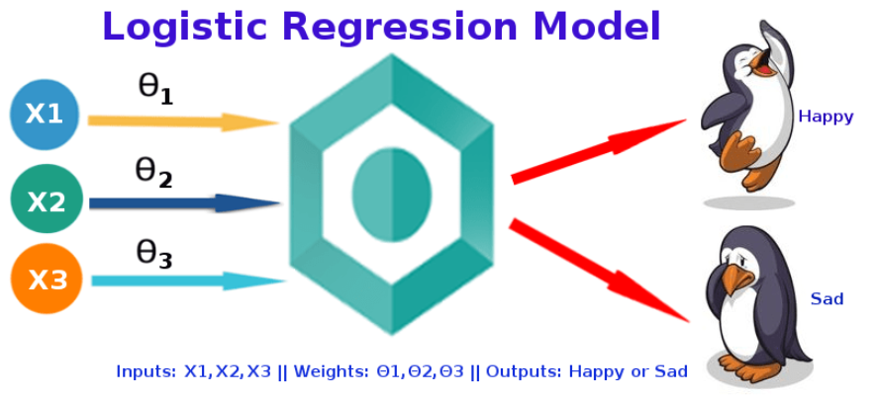
“Logistic regression measures the relationship between the categorical dependent variable and one or more independent variables by estimating probabilities using a logistic function”
Logistic Regression was used in the biological sciences in early twentieth century. It was then used in many social science applications. Logistic Regression is used when the dependent variable(target) is categorical.
For example,
To predict whether an email is spam (1) or (0)
Whether the tumor is malignant (1) or not (0)

Slide 3
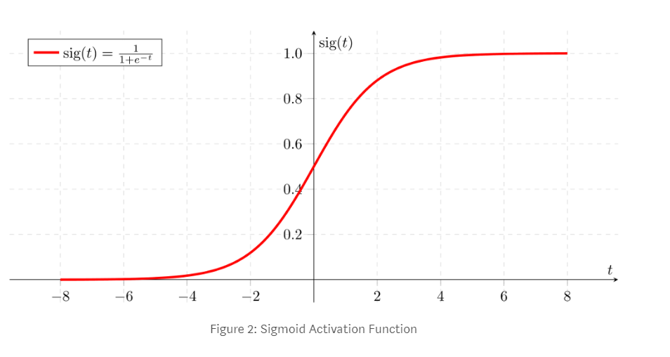
Sigmoid Function
If ‘Z’ goes to infinity, Y(predicted) will become 1 and if ‘Z’ goes to negative infinity, Y(predicted) will become 0.

Slide 4
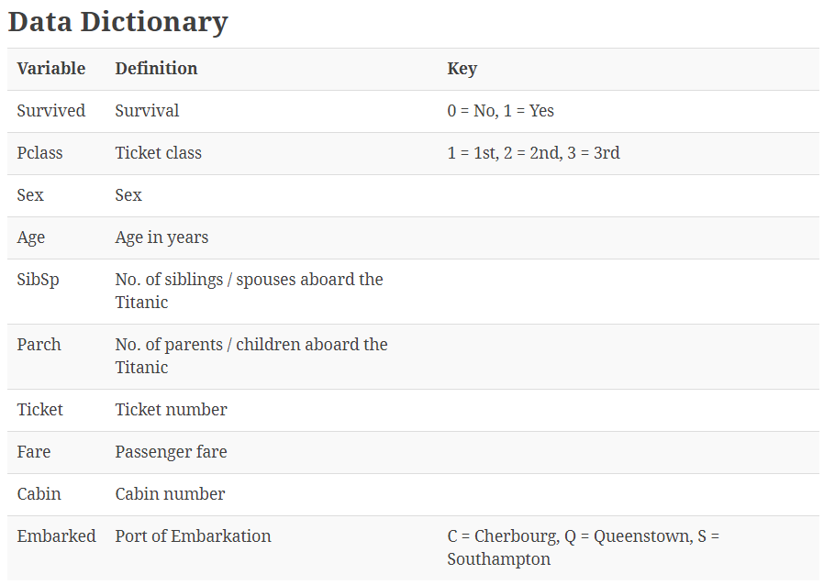

Slide 5
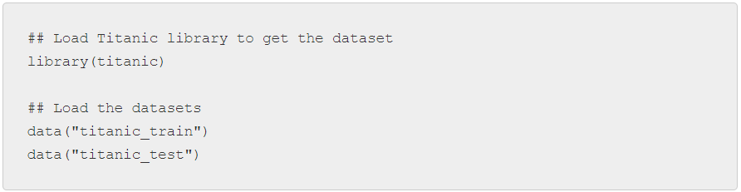
R Code
Loading the dataset
Titanic package in R has both training and test datasets. So we will use this package to directly load the dataset.

Slide 6
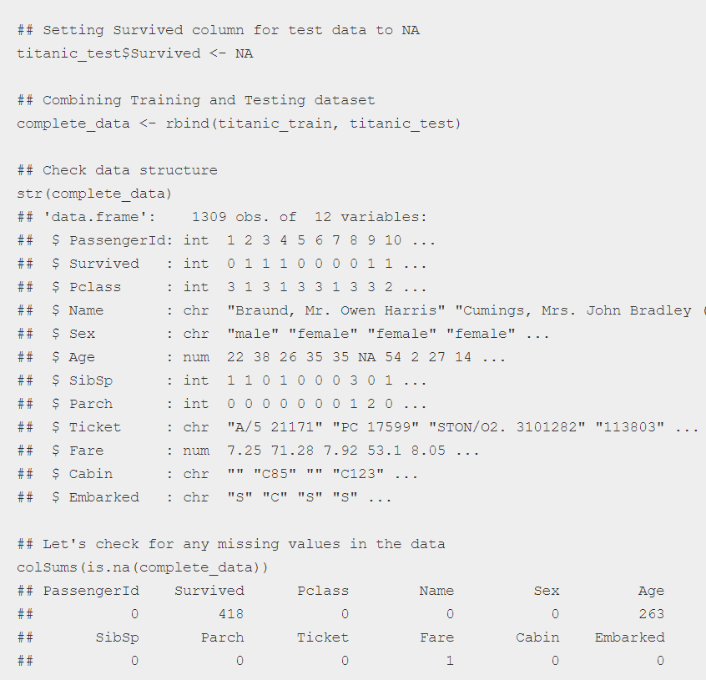
Data details and missing values imputation

Slide 7
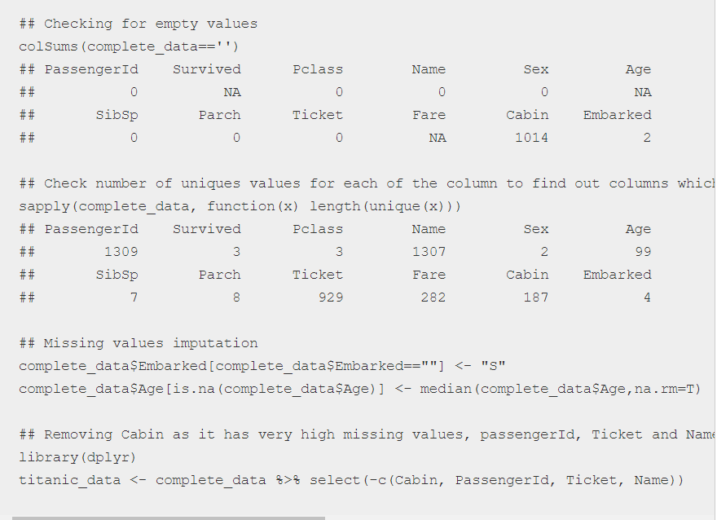

Slide 8
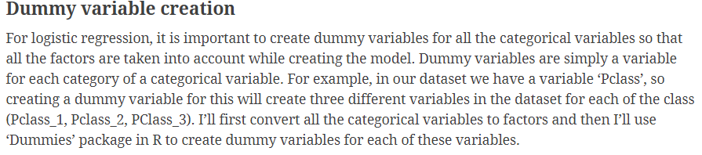
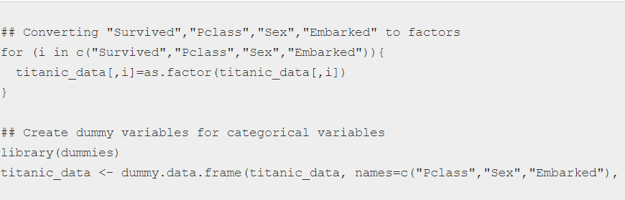


Slide 9
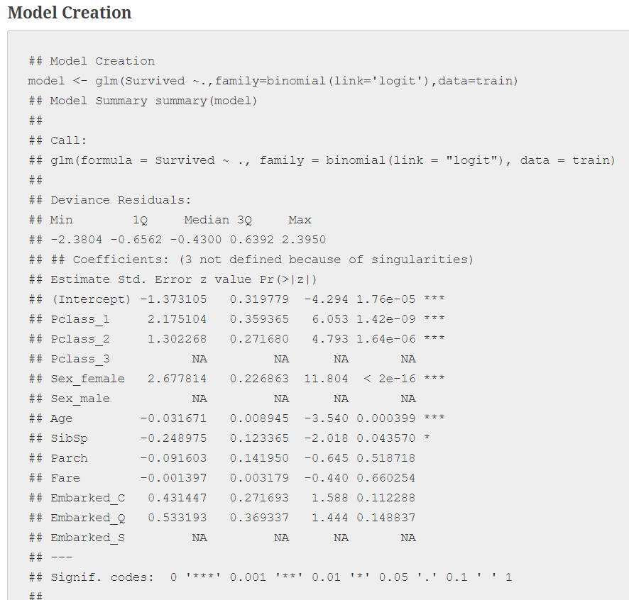

Slide 10
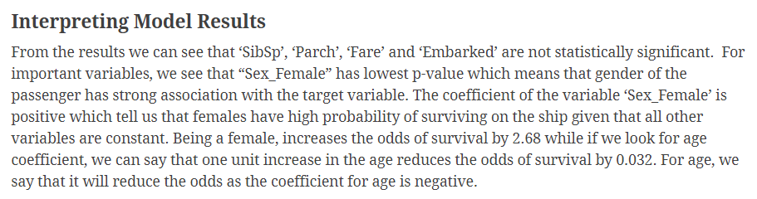

Slide 11
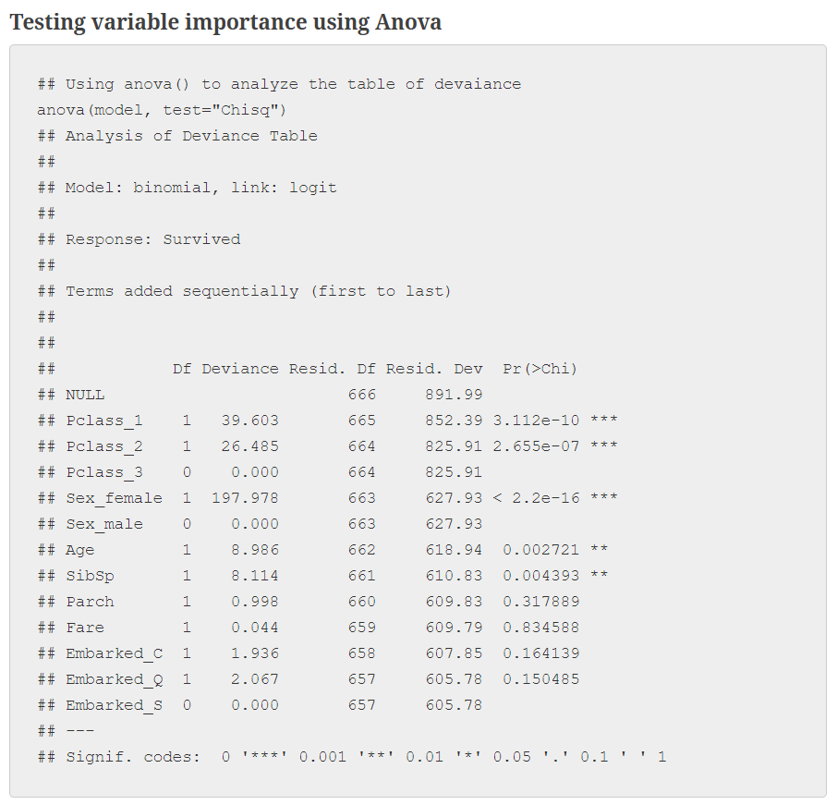
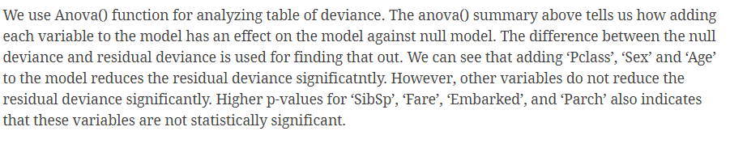

Slide 12
